Slide 1
Correlated quantum phenomena in the strong spin-orbit regime
Tejas Deshpande
(24 September 2013)

Slide 2
Outline
Introduction
Weak to intermediate correlations
  Pyrochlore iridates
    Experimental resume
    Electronic structure
    Magnetism and Weyl fermions
    The role of many-body effects
    Interactions with rare earth moments
    Issues and Outlook
Strong Mott Regime
  Full degeneracy lifting and honeycomb iridates
  Partial degeneracy lifting and ordered double perovskites
    Double perovskites
    Multipolar exchange
    Mean field theory
    Beyond mean-field theory
    Connections to experiments
Concluding Remarks and Outlook

Slide 3
I. Introduction
Two central threads of quantum materials research
  Correlated electron physics (e.g. mainly 3d transition metal oxides)
    Local moment formation and magnetism
    Quantum criticality
    Unconventional superconductivity
  Non-trivial physics from strong Spin-Orbit Coupling (SOC)
    f-electron materials
    Topological insulators and superconductors (s- and p- orbitals)
What about systems with correlation + SOC?
  Heavy Transition Metal Oxides (TMOs) mainly from 5d series
  Both SOC and electronic repulsion strengths, λ and U respectively, become comparable
  Several arguments suggest that λ and U tend to cooperate rather than compete
A mean-field model: Hubbard model with SOC
No correlations and no SOC
with SOC
with correlations

Slide 4
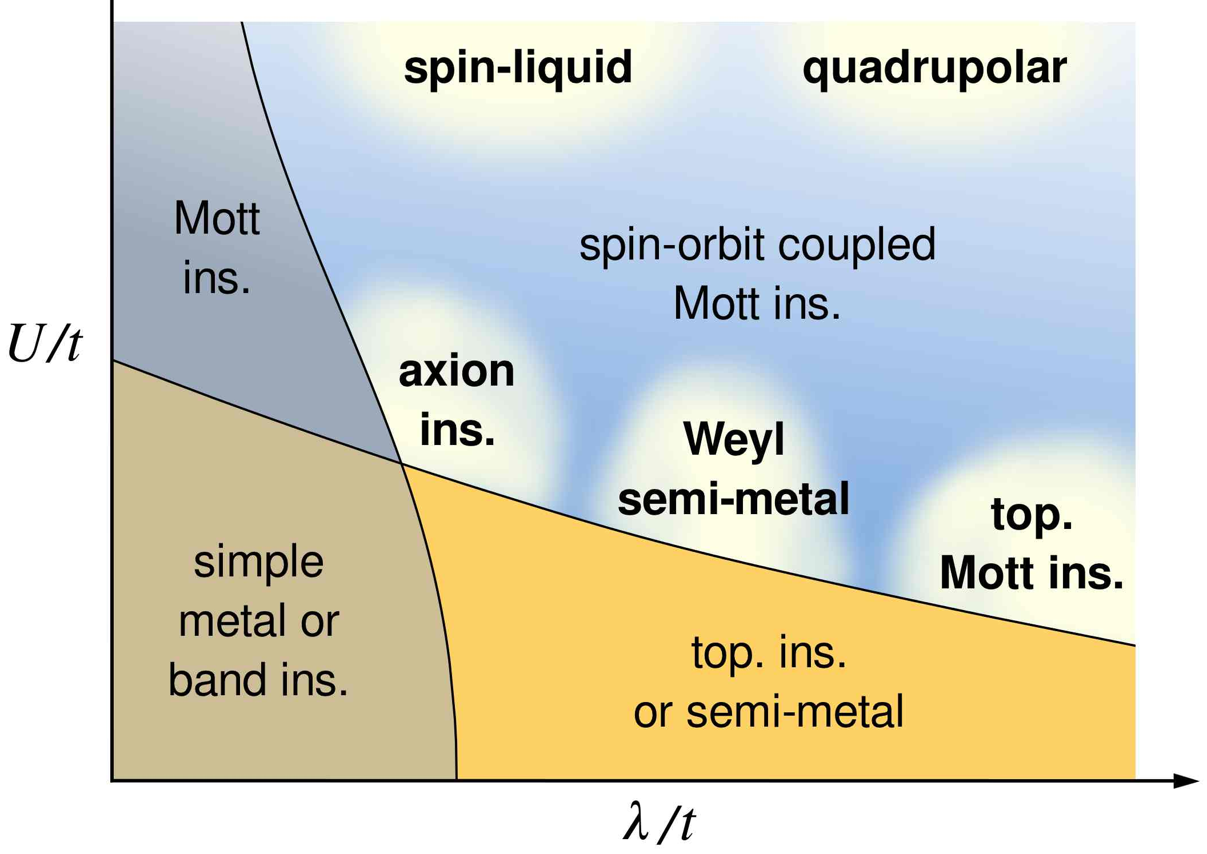
I. Introduction
A mean-field model: Hubbard model with SOC
No correlations and no SOC
with SOC
with correlations
strong Mott limit
1980s
2010s??
weak-to-intermediate correlation regime
1930s
2000s

Slide 5
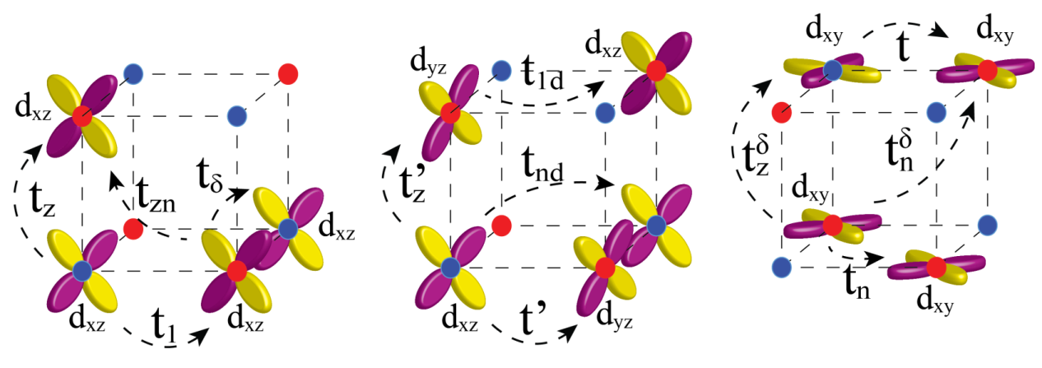

I. Introduction
A mean-field model: Hubbard model with SOC
No correlations and no SOC
with SOC
with correlations
Consider example: Sr₂IrO₄
Kinetic energy with which electron hops from site j to i
Angular momentum (L_{i}) and spin (S_{i}) of electrons on site i couple
Energy cost of repulsion between electrons on the same site = U
  One electron localized per site
The operator counts the number of electrons on site i in orbital α
Last terms kicks in when

Slide 6
I. Introduction
Proposals for Iridates
Emergent quantum phases in correlated spin-orbit coupled materials. Abbreviations are as follows: TME = topological magnetoelectric effect, (F)QHE = (fractional) quantum Hall effect. Correlations are W-I = weak-intermediate, I = intermediate (requiring magnetic order, say, but mean field-like), and S = strong.
Phase | Correlation | Properties | Proposed Materials
Axion Insulator | W-I | Magnetic insulator, TME, no protected surface states | R₂Ir₂O₇
Weyl semi-metal | I | Dirac-like bulk states, surface Fermi arcs, anomalous Hall | R₂Ir₂O₇
Chern Insulator | W-I | Bulk gap, QHE | SrIrO₃
Fractional Chern Insulator | I-S | Bulk gap, FQHE | SrIrO₃
Fractional Topological Insulator, Topological Mott Insulator | I-S | Several possible phases. Charge gap, fractional excitations | R₂Ir₂O₇
Quantum spin liquid | S | Several possible phases. Charge gap, fractional excitations | Na₂IrO₃

Slide 7
II. Weak to Intermediate Correlations
Topological insulators: non-trivial topology of the bands in a gapped system
Gapless systems: Weyl semi-metals (WSMs)
Notion of band topology ➔ some degree of itinerancy
Non-TI, but still topological phases, require: intrinsic symmetry breaking
Any form of intrinsic magnetization ➔ correlations “weak” enough for mean-field
Examples of non-TI topological phases:
  Antiferromagnetic Topological Insulator (AFTI)
  Axion Insulator
  Weyl semi-metal
Strong Mott regime ➔ electrons atomically localized; “band” topology doesn’t make sense
Exotic phases due to orbital- and spin-ordering when both are entangled
The spin + orbit entanglement lifts degeneracies of the ground states to give interesting lattice models

Slide 8
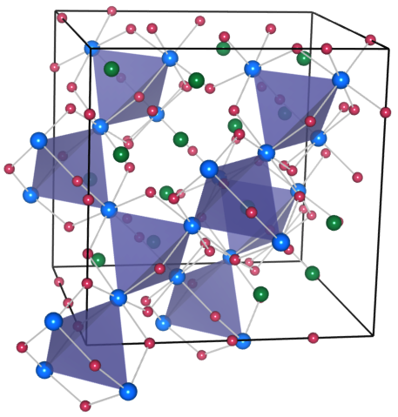
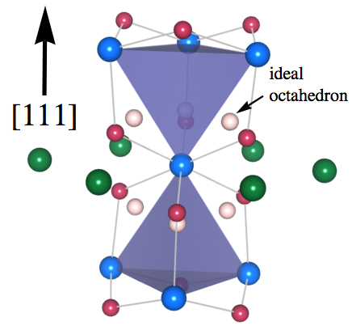
II. Weak to Intermediate Correlations
A.
Pyrochlore iridates
Formula: R₂Ir₂O₇ where R is a rare earth element

Slide 9
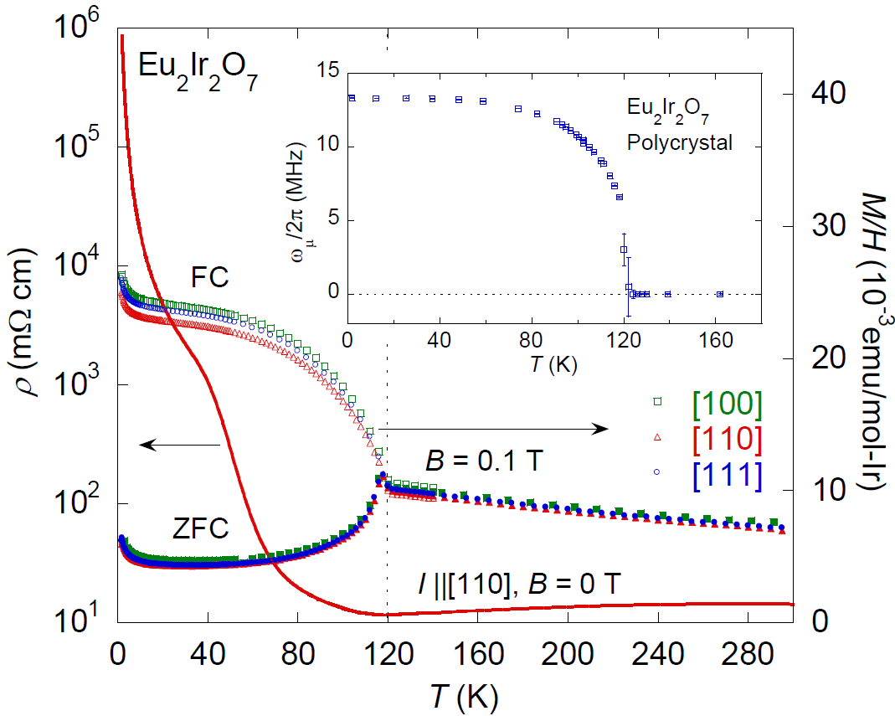
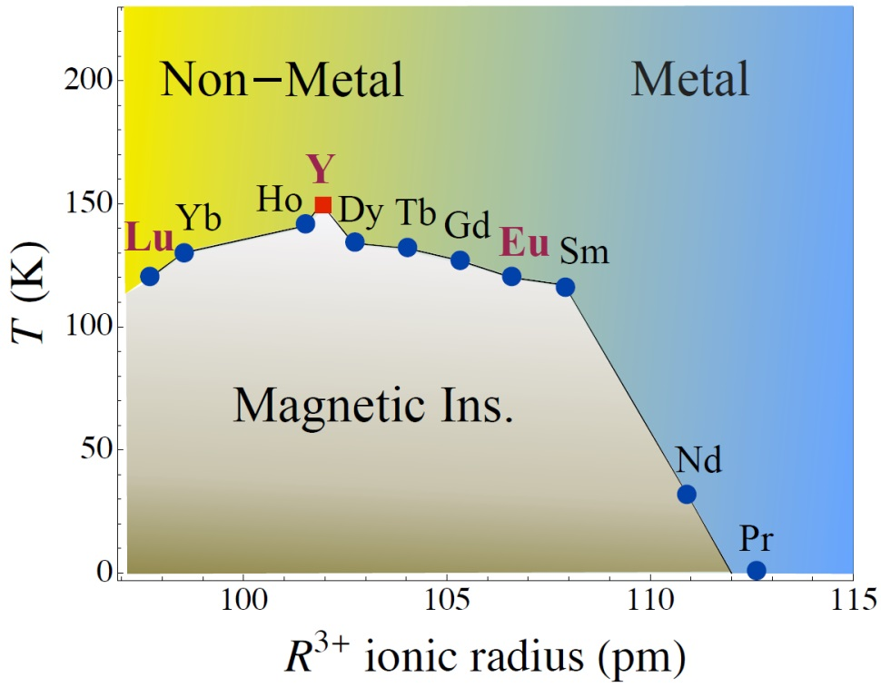
II. Weak to Intermediate Correlations
A.
Pyrochlore iridates
1.
Experimental resume
Resistivity goes from being “metallic” (dρ/dT > 0) at T > T_{c} to “non-metallic” (dρ/dT < 0) at T < T_{c}
The rare earth ion affects crystal field splitting; T_{c} is changed
Larger R³⁺ cation ➔ more metallicity; larger cation ➔ decreased trigonal compression ➔ increased the Ir-O orbital-overlap

Slide 10
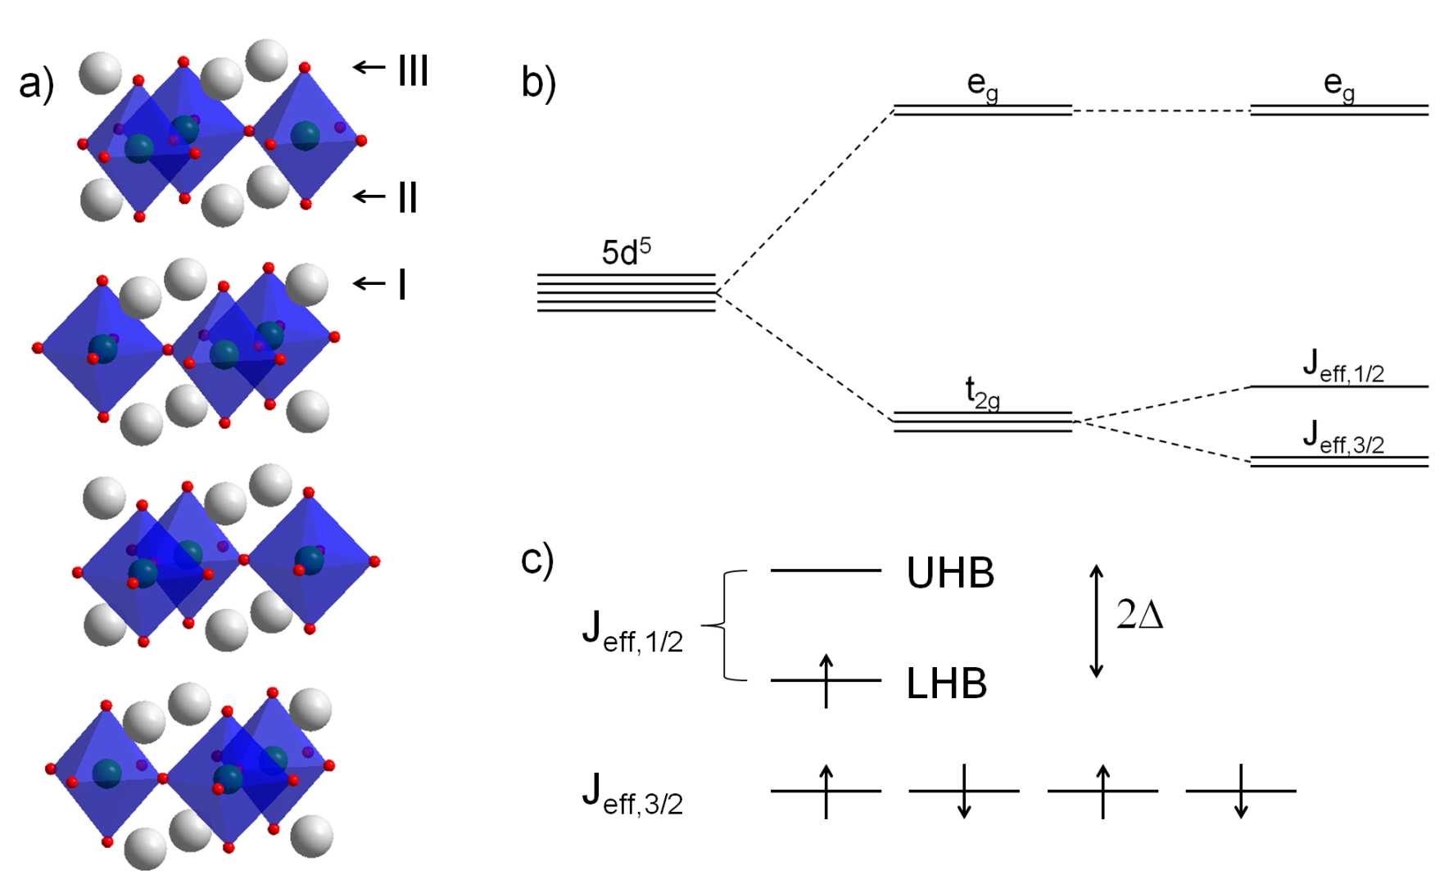


II. Weak to Intermediate Correlations
A.
Pyrochlore iridates
2.
Electronic structure
Focus on Ir-electron physics; neglect the rare earth magnetism (relevant at very low temperatures)
Outer-shell electrons of Ir⁴⁺ cation are in a 5d⁵ configuration
Full angular momentum operator projected to the t_{2g} manifold:
SOC splits the t_{2g} spinful manifold into a higher energy J_{eff} = 1/2 doublet and a lower J_{eff} = 3/2 quadruplet
Only (half-filled) J_{eff} = 1/2 doublet near the Fermi energy; 2 bands per Ir atom
4 Ir atoms in the tetrahedral unit cell ➔ total 8 Bloch bands near Fermi energy

Slide 11
II. Weak to Intermediate Correlations
A.
Pyrochlore iridates
2.
Electronic structure
Consider band structure of the 8 Bloch bands near the Γ point
Classification of 8 Bloch bands: two 2-D irreps and one 4-D irrep (cubic symmetry)
Pesin and Balents obtained “4-2-2”
The “2-2-4” and “4-2-2” can be TIs due to insulating ground state
2
2
2+2
Yang et al. found “2-4-2” metallic state due to trigonal distortion
Wan et al. also found “2-4-2” metallic state from LDA calculations
TI state in (metallic) Y₂Ir₂O₇ is impossible
Increase distortion ➔

Slide 12
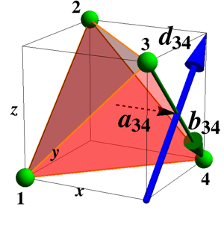
II. Weak to Intermediate Correlations
A.
Pyrochlore iridates
2.
Electronic structure
Convenient tight-binding model for both metallic and insulating regimes
Gives non-trivial Berry phase
Diagonalization gives “2-4-2” semi-metallic state for –2 ≤ t₂/t₁ ≤ 0 and a Topological Insulator otherwise
Semi-metallic state is a zero-gap semiconductor
This semi-metallic state forms stable non-Fermi liquid phase with a quadratic band touching at the Γ point: “Luttinger-Abrikosov-Beneslavskii” (LAB) phase
About LAB:
  Electron-hole pair excitations susceptible to “excitonic instability” due to unscreened Coulomb interactions
  Excitonic instability circumvented in the presence of time-reversal and cubic symmetries
  Enormous zero field anomalous Hall effect

Slide 13
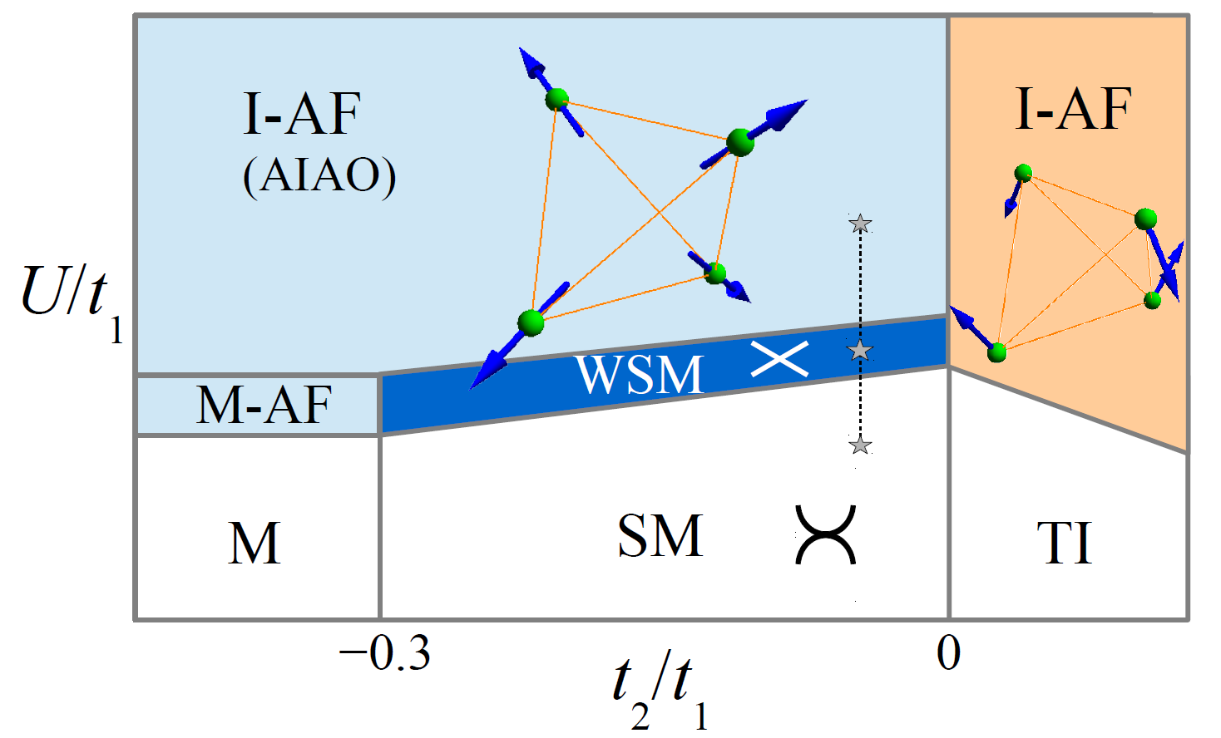
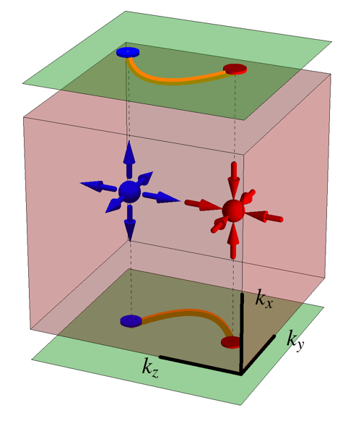
II. Weak to Intermediate Correlations
A.
Pyrochlore iridates
2.
Electronic structure
Convenient tight-binding model for both metallic and insulating regimes

Slide 14
II. Weak to Intermediate Correlations
A.
Pyrochlore iridates
3.
Magnetism and Weyl Fermions
Local C₃ axes for four Ir ions constituting a tetrahedron
Experiments suggest “all-in/all-out” (AIAO) ground state
Wan et al. found Weyl semi-metal with 24 Weyl nodes and suggested an axion insulator state
4.
The role of many-body effects
TI, AIAO, WSM stable to (perturbative) interactions
Axion insulator state appears in the CDMFT analysis but not at the Hartree-Fock level
Wang et al. formulated Z₂ invariant in terms of zero-frequency Green’s function
Both CDMFT and Hartree-Fock theory cannot capture topological Mott insulator

Slide 15
II. Weak to Intermediate Correlations
A.
Pyrochlore iridates
5.
Interactions with rare earth moments
What about interactions between R-site f-electrons and the Ir d-electrons?
Non-Kramers R³⁺ ions (R = Pr, Tb, Ho) have an even and Kramers ions (R = Nd, Sm, Gd, Dy, Yb) have an odd number of f-electrons
Example: Yb₂Ir₂O₇; two ordering temperatures: T_{M} = 130 K (Ir sublattice) and T* ≈ 20 K (Yb sublattice)
Most studied f-electron physics in iridates: Pr₂IrO₇ (no MIT)
Zero field anomalous Hall effect at 0.3 K < T < 1.5 K
Pr moments exhibit spin-ice type physics; “2-in/2-out” configurations on each tetrahedron
Pr ordering via RKKY interaction
Chen et al. suggest coupling to Ir may help to stabilize the WSM and axion insulator phases

Slide 16
II. Weak to Intermediate Correlations
A.
Pyrochlore iridates
6.
Issues and Outlook
Pyrochlore iridates undergo MIT with the onset of AIAO magnetic order
Nd₂Ir₂O₇: AIAO at the Nd-sites may imply AIAO at the Ir-sites
Resonant x-ray diffraction measurements suggest Eu₂Ir₂O₇ has AIAO order
  Generation of the spin-orbit exciton

Slide 17
III. Strong Mott Regime
Electrons effectively localized to single atoms
Description in terms of local spin and orbital degrees of freedom (DOF) applies
Charge gap ≫ energy of spin and orbital excitations
Notion of band topology does not make sense
Orbital degeneracy resolved in a unique way
Orbital DOF behaves as additional “pseudo-spin” quantum variable
Exchange of spin + pseudo-spin ➔ Kugel-Khomskii models
Jahn-Teller effect ➔ lattice distortions split orbital degeneracy
“Quantumness” washed away by phonon modes
SOC trades Jahn-Teller effect for entanglement of spin and orbital DOF
3-fold degenerate for 1, 2, 4, and 5 electrons
2-fold degenerate for 1 and 3 electrons
Exchange of spin + pseudo-spin ➔ possibilities of exotic new ground states
Quantum spin liquid and multipolar ordered phases possible in honeycomb iridates and the double perovskites

Slide 18
III. Strong Mott Regime
A.
Full degeneracy lifting and honeycomb iridates
Ir⁴⁺ with 5d⁵ ➔ orbital degeneracy removed completely
Na₂IrO₃ and Li₂IrO₃ ➔ Ir⁴⁺ + strong Mott regime
Anisotropic exchange model
The only example of an exactly soluble model for a quantum spin liquid state!
No magnetic order + charge-neutral “spin”-carrying elementary excitations ➔ Majorana fermions!
Unfortunately experiments on Na₂IrO₃ have not confirmed the Kitaev model yet

Slide 19
III. Strong Mott Regime
B.
Partial degeneracy lifting and ordered double perovskites
Need only 1 or 2 electrons in the 4d or 5d shells ➔ strongly spin-orbit coupled analogs of Ti³⁺ and V³⁺ or V⁴⁺
V³⁺ or V⁴⁺ constitute classic families undergoing Mott transitions
With SOC, degeneracy lifting same as before
d¹ case ➔ local J_{eff} = 3/2 spin
d² case ➔ two parallel (spin-1/2) electrons with aligned spins due to Hund’s rule ➔ total spin S = 1
Since t_{2g} has L_{eff} = 1, J_{eff} = L_{eff} + S = 2
Overall degeneracy for d¹ (d²) case is 4 (5)
Multipolar spin exchange common for large J_{eff}
Multipolar interactions connect directly states with very different S^{z} quantum numbers ➔ wavefunction delocalization in spin space

Slide 20
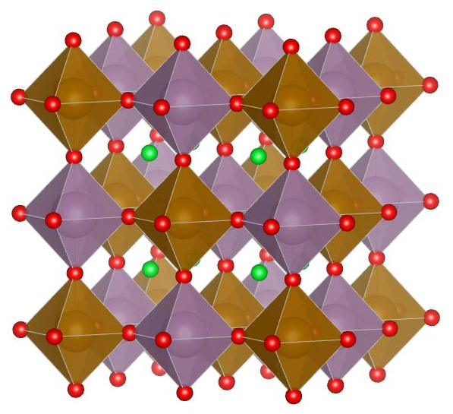
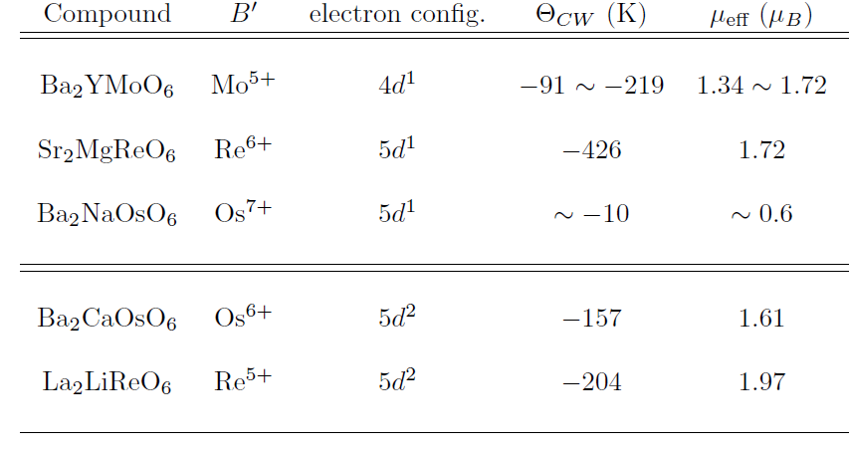
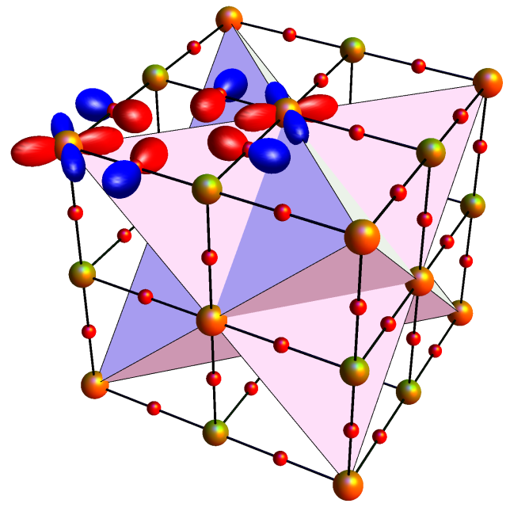
III. Strong Mott Regime
B.
Partial degeneracy lifting and ordered double perovskites
1.
Double perovskites
A₂BB′O₆ ➔ regular ABO₃ perovskites with alternating B (non-magnetic) and B′ (magnetic) atoms
Consequence of SOC ➔ for J_{eff} = 3/2 the g-factor vanishes
Magnetic entropy (Rln(4)) estimated from experiments ➔ indication of strong SOC

Slide 21
III. Strong Mott Regime
B.
Partial degeneracy lifting and ordered double perovskites
2.
Multipolar exchange
Consider Kugel-Khomskii type exchange with all orbitals are included ➔ then project to the effective spins in the strong SOC limit
For d¹ case consider exchange:
Consider Kugel-Khomskii type exchange with all orbitals are included ➔ then project to the effective spins in the strong SOC limit
In strong for t_{2g} we have
Performing the projections we get
For d¹ we have two exchange channels: ferromagnetic exchange between orthogonal orbitals (J′) and electrostatic quadrupole interaction (V)

Slide 22
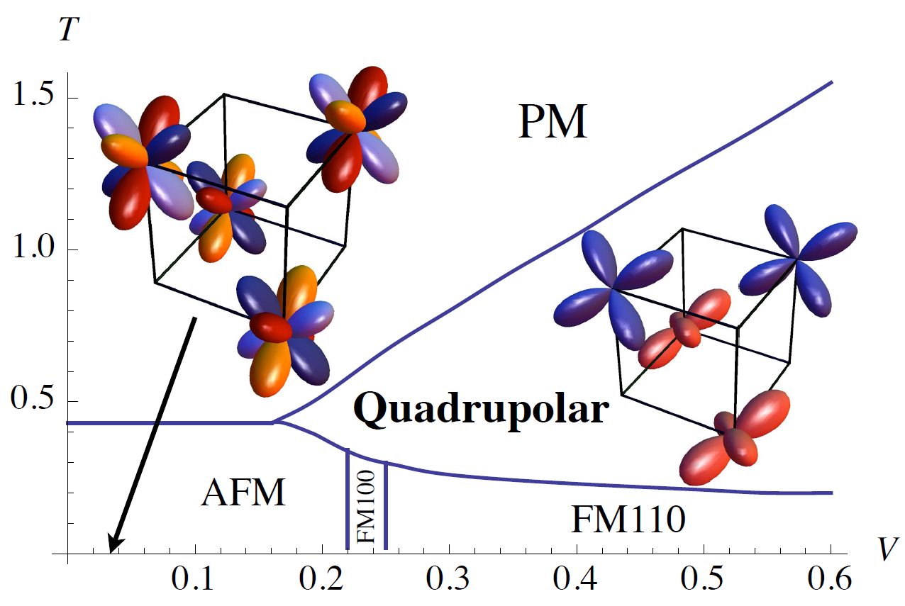
III. Strong Mott Regime
B.
Partial degeneracy lifting and ordered double perovskites
3.
Mean field theory
Exotic phases even in mean field
Anisotropic contributions come from quadrupolar and octupolar interactions
Antiferromagnetic phase for small J′/J and V/J
Ferromagnetic phases (FM110 and FM100) for large J′/J and V/J
Quadrupolar states classified by eigenstates of
Only 1 independent eigenvalue (q, q, -2q) ➔ Uniaxial nematic phase
2 independent eigenvalues (q₁, q₂, –q₁, –q₂) ➔ Biaxial nematic phase
Quadrupolar phase appears in d² perovskite even for T = 0; d1 must always break time reversal symmetry at T = 0 to avoid ground state degeneracy.

Slide 23
III. Strong Mott Regime
B.
Partial degeneracy lifting and ordered double perovskites
4.
Beyond mean-field theory
Multipolar interactions destabilize conventional, magnetically ordered semiclassical ground states
More “spin flip” terms analogous to the S_{i}⁺S_{j}– couplings
Quantum disordered ground states can be established rigorously for AKLT models
Multipolar Hamiltonians are intermediate between conventional spin models and these special cases
Check for disordered states ➔ gauge the magnitude of quantum fluctuations within a spin-wave expansion
Valence bond solids and quantum spin liquid states predicted in various parameter regimes
Non-cubic crystal fields give highly frustrated systems ➔ quantum fluctuations support a spin liquid phase

Slide 24
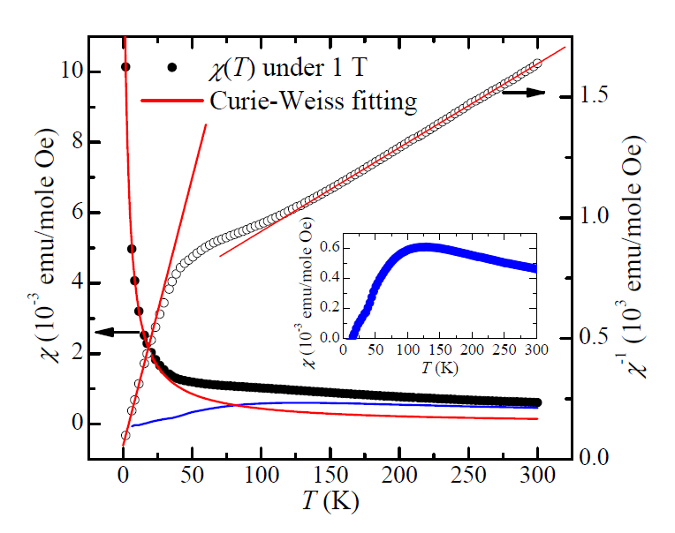
III. Strong Mott Regime
B.
Partial degeneracy lifting and ordered double perovskites
5.
Connections to experiments
Ba₂YMoO₆ cubic to low temperatures
Like many double perovskites has a two Curie regime
Phonon mode above 130 K; consistent with local structural change
Ba₂NaOsO₆ has a ferromagnetic ground state below 6.8 K with [110] easy axis
Landau theory predicts [100] or [111] as the easy axis
Quadrupolar ordering mechanism can account for it; associates with a structural change; not observed so far

Slide 25
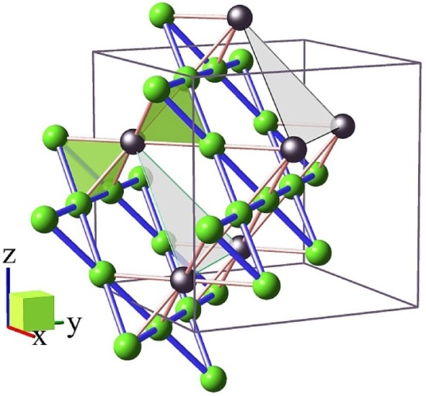
IV. Concluding Remarks and Outlook
Not discussed ➔ Ruddlesdon-Popper series of perovskite iridates ➔ formula for a n-layer quasi-2D system ➔ Sr_{n+1}Ir_{n}O_{3n+1} for n = 1, 2, ∞
The n = 1 case (Sr₂IrO₄) expected to be a high-Tc superconductor, upon doping, owing to its similarity cuprate parent compound to La₂CuO₄
This review mainly discusses bandwidth controlled MITs; filling (or doping) controlled MITs might reveal interesting physics
Exotic fractionalized phases possible: fractional Chern insulators from heterostructures of SrIrO₃-SrTiO₃
Controversies ➔ Mott vs. Slater insulator in Sr₂IrO₄? ➔ contradictory results from different calculations ➔ experimental evidence needed
Heterostructures of SrIrO₃ and R₂Ir₂O₇ along the [111] direction can give topological insulators and IQHE

Slide 26
References
William Witczak-Krempa, Gang Chen, Yong Baek Kim, and Leon Balents. “Correlated quantum phenomena in the strong spin-orbit regime.” arXiv preprint arXiv:1305.2193 (2013)

